Slide 1
Community Metabolic Modelling and Validation Framework
Noor Alsmadi
PhD Candidate
University of Toronto
July 25th 2024

Slide 2
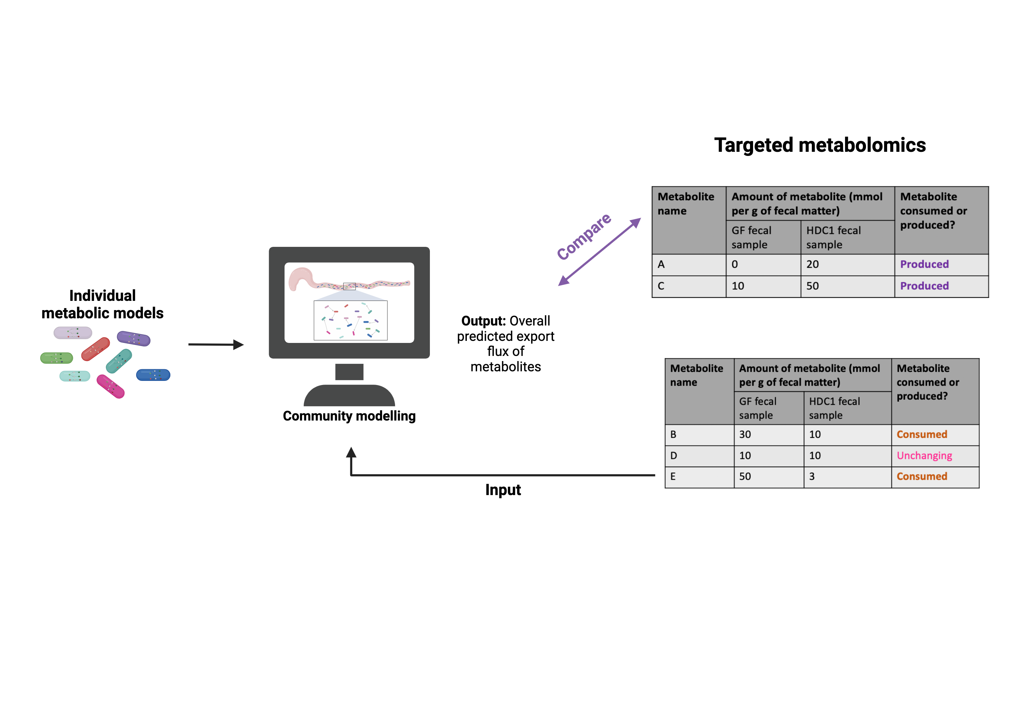
Goal: Establish a community genome-scale metabolic modelling framework for defined gut bacterial communities and validate it using targeted metabolomics data.
Created with BioRender

Slide 3
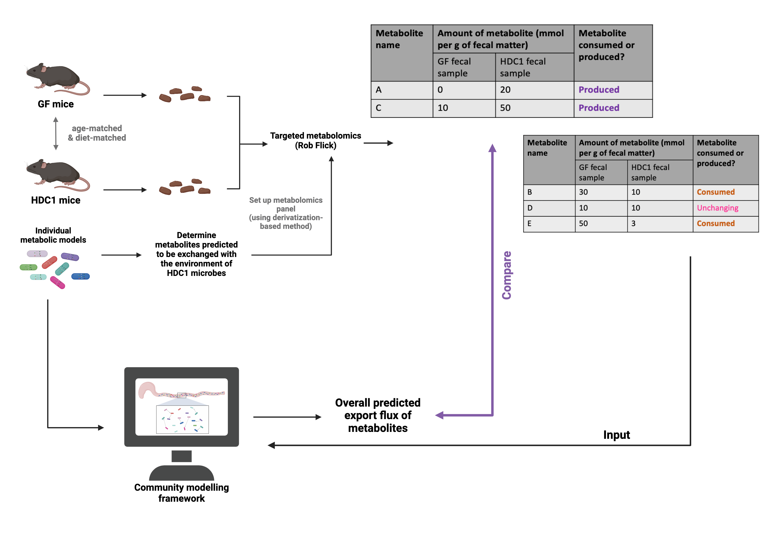
Community Metabolic Modelling and Validation Framework
Created with BioRender

Slide 4

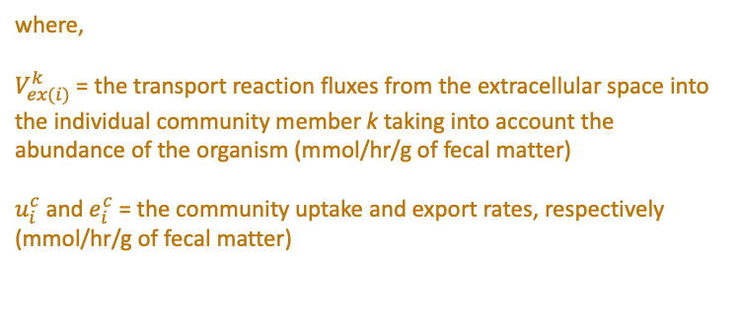
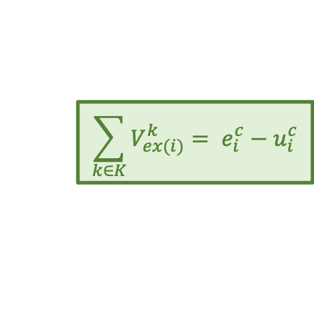
Community Metabolic Modelling and Validation Framework
Assumption 1: All members of HDC1 can interact and cross-feed with each other
$$\sum_{k∈K}{V_{ex(i)}^{k}= e_{i}^{c}−u_{i}^{c}}$$
where,
$V_{ex(i)}^{k}$ = the transport reaction fluxes from the extracellular space into the individual community member k taking into account the abundance of the organism (mmol/hr/g of fecal matter)
$u_{i}^{c}$ and $e_{i}^{c}$ = the community uptake and export rates, respectively (mmol/hr/g of fecal matter)
Created with BioRender

Slide 5
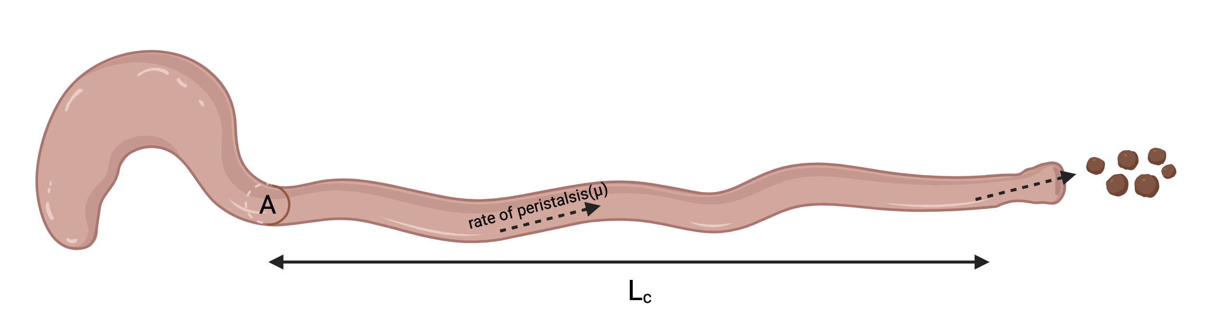
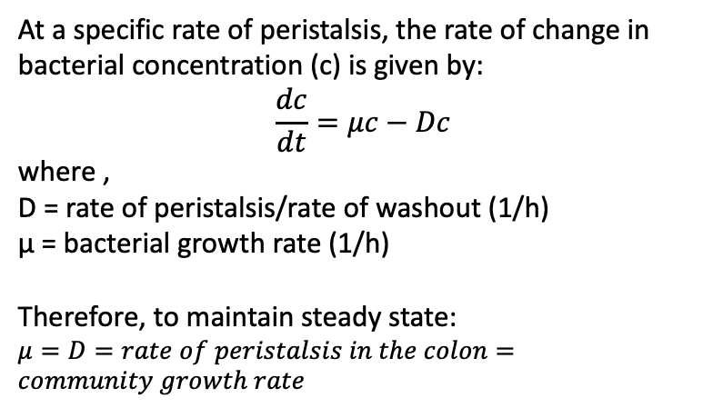
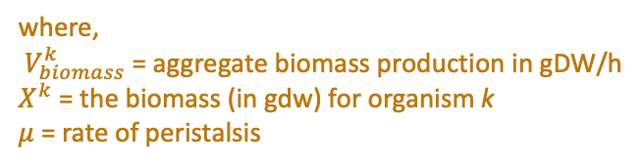

Community Metabolic Modelling and Validation Framework
Assumption 2: HDC1 is at steady state in mice.
Giuliano Bayer,
PhD candidate,
Philpott Lab
At a specific rate of peristalsis, the rate of change in bacterial concentration (c) is given by:
$$\frac{dc}{dt}=μc−Dc$$
where ,
D = rate of peristalsis/rate of washout (1/h)
μ = bacterial growth rate (1/h)
Therefore, to maintain steady state:
$μ=D=rate of peristalsis in the colon=community growth rate$
HDC1 = Human Defined Community 1 (subset of MET-1)
*detected in fecal pellets
*
*
*
*
*
*
*
*
→ in fecal pellets: Bifidobacterium sp.
Parental wk2
Parental wk4
Parental wk12
F1
Litter 1 wk5
F1
Litter 2 wk5
Small intestine (SI), Cecum (Ce), Colon (C)
MET1_inoculum_1
MET1_inoculum_2
$$V_{biomass}^{k}=X^{k}μ$$
where,
$V_{biomass}^{k}$ = aggregate biomass production in gDW/h
$X^{k}$ = the biomass (in gdw) for organism k
$μ$ = rate of peristalsis
Created with BioRender

Slide 6
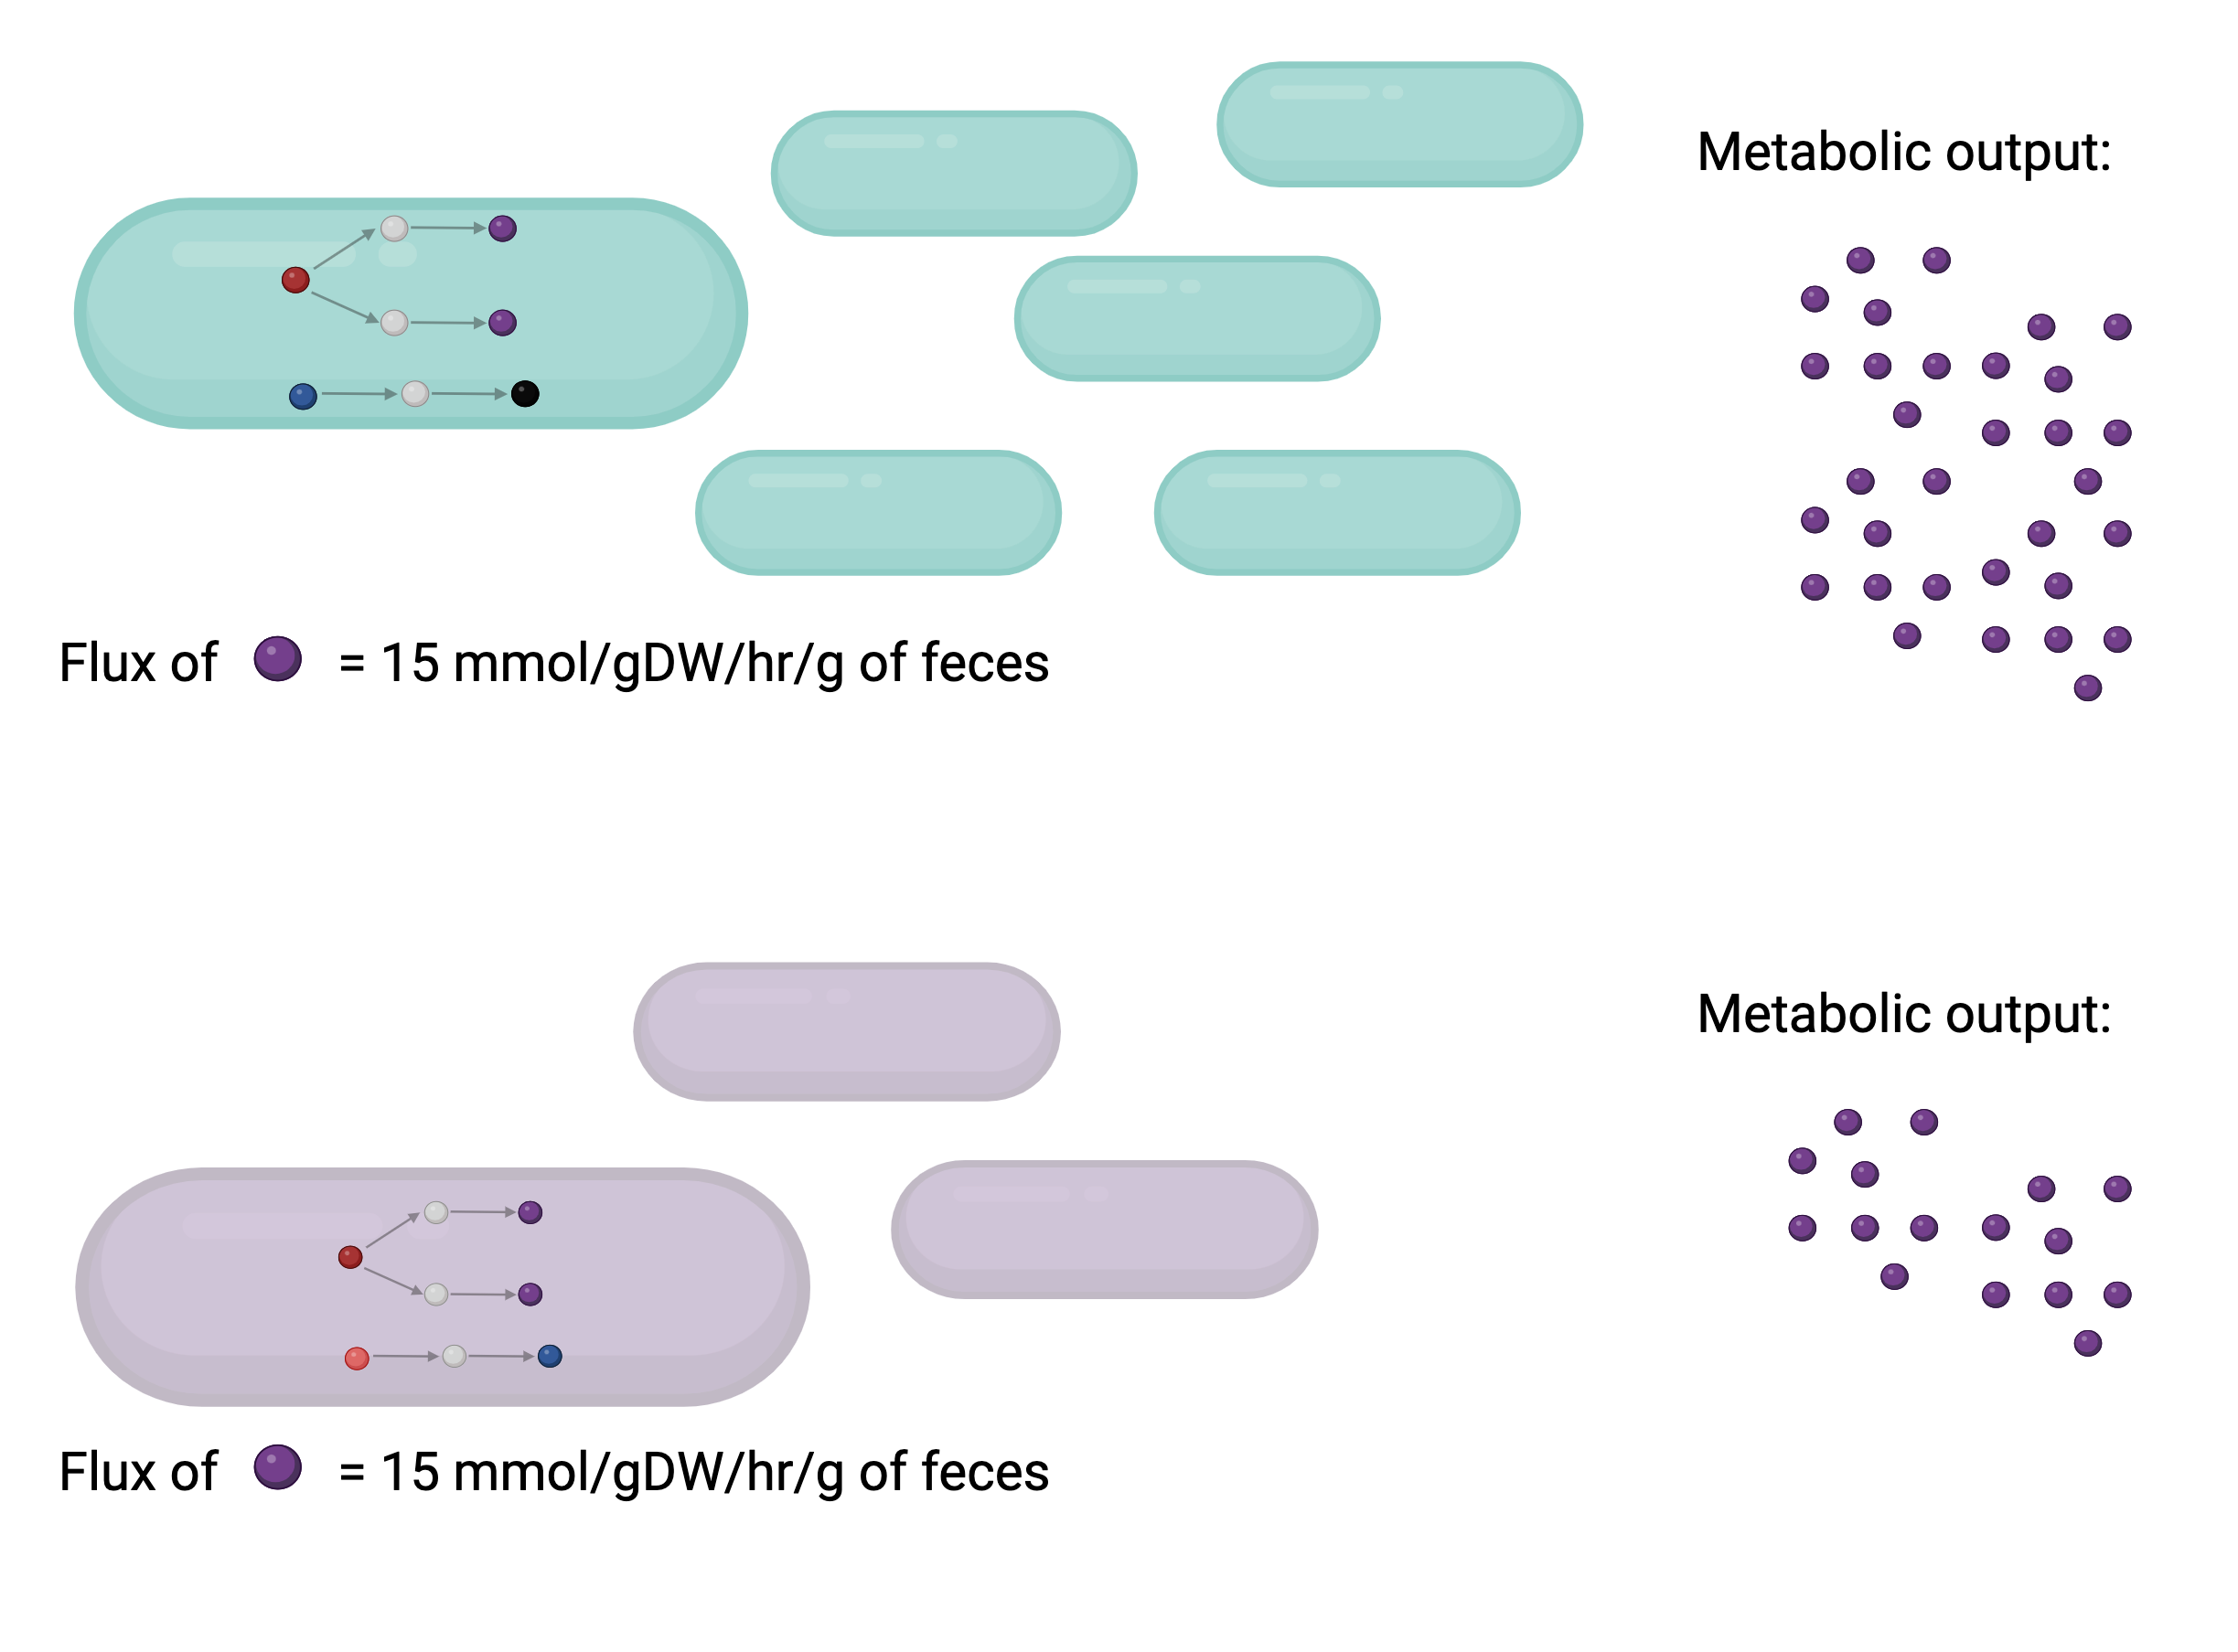
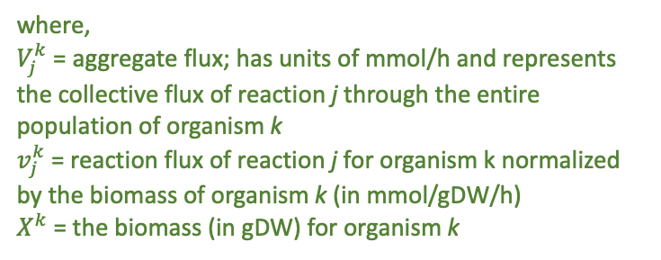

Community Metabolic Modelling and Validation Framework
The overall flux of a metabolite out of an organism is proportional to its relative abundance in the community.
$$V_{j}^{k}=X^{k}v_{j}^{k}$$
where,
$V_{j}^{k}$ = aggregate flux; has units of mmol/h and represents the collective flux of reaction j through the entire population of organism k
$v_{j}^{k}$ = reaction flux of reaction j for organism k normalized by the biomass of organism k (in mmol/gDW/h)
$X^{k}$ = the biomass (in gDW) for organism k
Created with BioRender

Slide 7


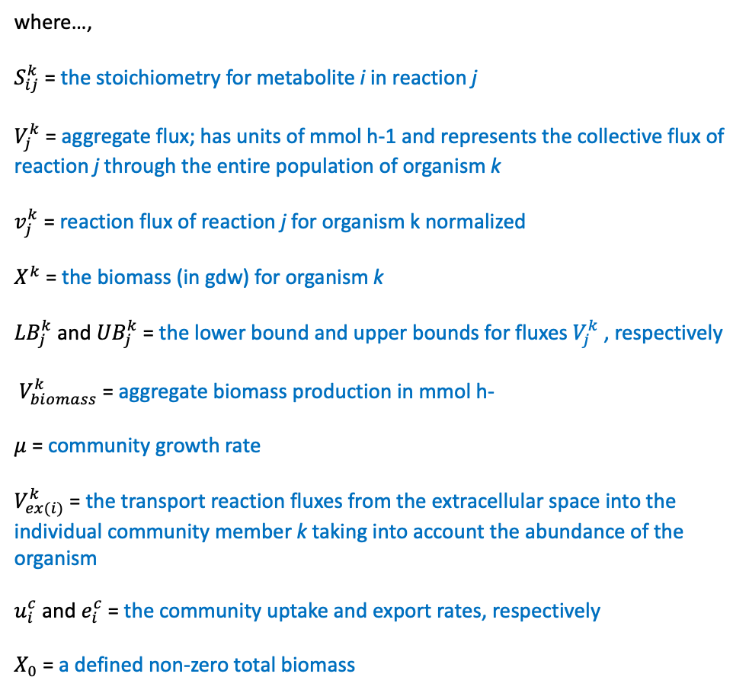
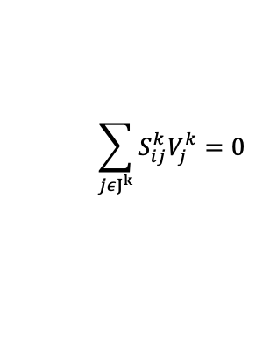

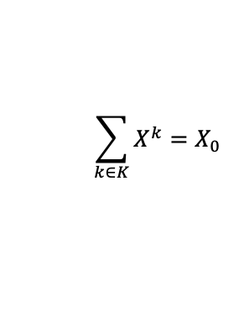

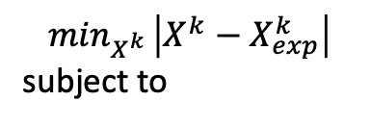




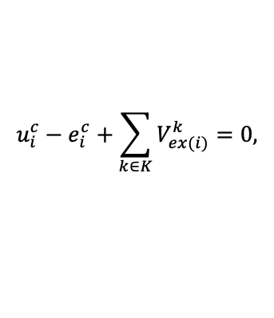



Adapted SteadyCom Formulation
$$\min_{X^{k} }\left|X^{k}−X_{exp}^{k}\right|$$
subject to
where…,
$S_{ij}^{k}$ = the stoichiometry for metabolite i in reaction j
$V_{j}^{k}$ = aggregate flux; has units of mmol h-1 and represents the collective flux of reaction j through the entire population of organism k
$v_{j}^{k}$ = reaction flux of reaction j for organism k normalized
$X^{k}$ = the biomass (in gdw) for organism k
${LB}_{j}^{k}$ and ${UB}_{j}^{k}$ = the lower bound and upper bounds for fluxes $V_{j}^{k}$ , respectively
$V_{biomass}^{k}$ = aggregate biomass production in mmol h-
$μ$ = community growth rate
$V_{ex(i)}^{k}$ = the transport reaction fluxes from the extracellular space into the individual community member k taking into account the abundance of the organism
$u_{i}^{c}$ and $e_{i}^{c}$ = the community uptake and export rates, respectively
$X_{0}$ = a defined non-zero total biomass
$V_{j}^{k}=X^{k}v_{j}^{k}$, $∀j∈J^{k}$, $k∈K$
$$\sum_{jεJ^{k}}{S_{ij}^{k}V_{j}^{k}=0}$$
$$∀i∈I^{k}$$
$$∀k∈K$$
${LB}_{j}^{k}X^{k}≤V_{j}^{k}≤{UB}_{j}^{k}X^{k}$,
$$∀j∈J^{k}$$
$$V_{biomass}^{k}=X^{k}μ$$
$$X^{k}≥0$$
$$u_{i}^{c}−e_{i}^{c}+\sum_{k∈K}{V_{ex(i)}^{k}=0,}$$
$$∀i∈I^{com}$$
$$\sum_{k∈K}{X^{k}=X_{0}}$$
$$μ$$
,
$$e_{i}^{c}≥0$$
,
$$∀i∈I^{com}$$
Chan SHJ, Simons MN, Maranas CD. SteadyCom: Predicting microbial abundances while ensuring community stability. PLoS Comput Biol. 2017 May 15;13(5):e1005539. doi: 10.1371/journal.pcbi.1005539.

Slide 8
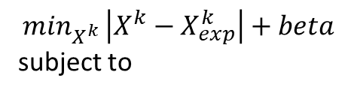
Adapted SteadyCom Formulation
$$\min_{X^{k} }\left|X^{k}−X_{exp}^{k}\right|+beta$$
subject to
where…,
$S_{ij}^{k}$ = the stoichiometry for metabolite i in reaction j
$V_{j}^{k}$ = aggregate flux; has units of mmol h-1 and represents the collective flux of reaction j through the entire population of organism k
$v_{j}^{k}$ = reaction flux of reaction j for organism k normalized
$X^{k}$ = the biomass (in gdw) for organism k
${LB}_{j}^{k}$ and ${UB}_{j}^{k}$ = the lower bound and upper bounds for fluxes $V_{j}^{k}$ , respectively
$V_{biomass}^{k}$ = aggregate biomass production in mmol h-
$μ$ = community growth rate
$V_{ex(i)}^{k}$ = the transport reaction fluxes from the extracellular space into the individual community member k taking into account the abundance of the organism
$u_{i}^{c}$ and $e_{i}^{c}$ = the community uptake and export rates, respectively
$X_{0}$ = a defined non-zero total biomass
$V_{j}^{k}=X^{k}v_{j}^{k}$, $∀j∈J^{k}$, $k∈K$
$$\sum_{jεJ^{k}}{S_{ij}^{k}V_{j}^{k}=0}$$
$$∀i∈I^{k}$$
$$∀k∈K$$
${LB}_{j}^{k}X^{k}≤V_{j}^{k}≤{UB}_{j}^{k}X^{k}$,
$$∀j∈J^{k}$$
$$V_{biomass}^{k}=X^{k}μ$$
$$X^{k}≥0$$
$$u_{i}^{c}−e_{i}^{c}+\sum_{k∈K}{V_{ex(i)}^{k}=0,}$$
$$∀i∈I^{com}$$
$$\sum_{k∈K}{X^{k}=X_{0}}$$
$$μ$$
,
$$e_{i}^{c}≥0$$
,
$$∀i∈I^{com}$$
Chan SHJ, Simons MN, Maranas CD. SteadyCom: Predicting microbial abundances while ensuring community stability. PLoS Comput Biol. 2017 May 15;13(5):e1005539. doi: 10.1371/journal.pcbi.1005539.

Slide 9
Community Metabolic Modelling and Validation Framework
Created with BioRender

Slide 10
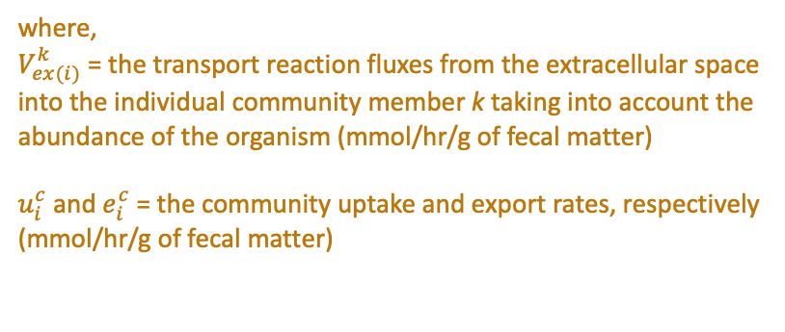
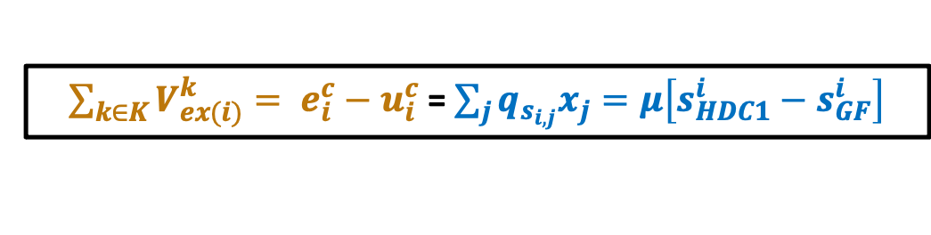
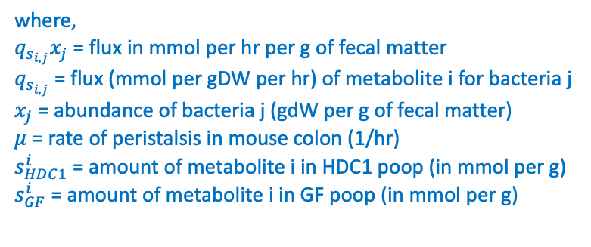
Community Metabolic Modelling and Validation Framework
Created with BioRender
$\sum_{k∈K}{V_{ex(i)}^{k}= e_{i}^{c}−u_{i}^{c}}$ = $\sum_{j}{q_{s_{i,j}}x_{j}=μ\left[s_{HDC1}^{i}−s_{GF}^{i}\right]}$
where,
$V_{ex(i)}^{k}$ = the transport reaction fluxes from the extracellular space into the individual community member k taking into account the abundance of the organism (mmol/hr/g of fecal matter)
$u_{i}^{c}$ and $e_{i}^{c}$ = the community uptake and export rates, respectively (mmol/hr/g of fecal matter)
where,
$q_{s_{i,j}}x_{j}$ = flux in mmol per hr per g of fecal matter
$q_{s_{i,j}}$ = flux (mmol per gDW per hr) of metabolite i for bacteria j
$x_{j}$ = abundance of bacteria j (gdW per g of fecal matter)
$μ$ = rate of peristalsis in mouse colon (1/hr)
$s_{HDC1}^{i}$ = amount of metabolite i in HDC1 poop (in mmol per g)
$s_{GF}^{i}$ = amount of metabolite i in GF poop (in mmol per g)

Slide 11
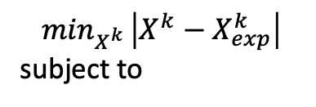

Community Metabolic Modelling and Validation Framework
$$\min_{X^{k} }\left|X^{k}−X_{exp}^{k}\right|$$
subject to
$V_{j}^{k}=X^{k}v_{j}^{k}$, $∀j∈J^{k}$, $k∈K$
$\sum_{k∈K}{V_{ex(i)}^{k}= e_{i}^{c}−u_{i}^{c}}$ = $\sum_{j}{q_{s_{i,j}}x_{j}=μ\left[s_{HDC1}^{i}−s_{GF}^{i}\right]}$
$$\sum_{jεJ^{k}}{S_{ij}^{k}V_{j}^{k}=0}$$
$$∀i∈I^{k}$$
$$∀k∈K$$
${LB}_{j}^{k}X^{k}≤V_{j}^{k}≤{UB}_{j}^{k}X^{k}$,
$$∀j∈J^{k}$$
Input experimental constraints
μ = rate of peristalsis (1/h)
$$V_{biomass}^{k}=X^{k}μ$$
$$X^{k}≥0$$
$$u_{i}^{c}−e_{i}^{c}+\sum_{k∈K}{V_{ex(i)}^{k}=0,}$$
$$∀i∈I^{com}$$
$$\sum_{k∈K}{X^{k}=X_{0}}$$
$$μ$$
,
$$e_{i}^{c}≥0$$
,
$$∀i∈I^{com}$$

Slide 12
Community Metabolic Modelling and Validation Framework
$$\min_{X^{k} }\left|X^{k}−X_{exp}^{k}\right|$$
subject to
$V_{j}^{k}=X^{k}v_{j}^{k}$, $∀j∈J^{k}$, $k∈K$
$\sum_{k∈K}{V_{ex(i)}^{k}= e_{i}^{c}−u_{i}^{c}}$ = $\sum_{j}{q_{s_{i,j}}x_{j}=μ\left[s_{HDC1}^{i}−s_{GF}^{i}\right]}$
$$\sum_{jεJ^{k}}{S_{ij}^{k}V_{j}^{k}=0}$$
$$∀i∈I^{k}$$
$$∀k∈K$$
${LB}_{j}^{k}X^{k}≤V_{j}^{k}≤{UB}_{j}^{k}X^{k}$,
$$∀j∈J^{k}$$
Output modelling results
Compare results
μ = rate of peristalsis (1/h)
$$V_{biomass}^{k}=X^{k}μ$$
$$X^{k}≥0$$
$$u_{i}^{c}−e_{i}^{c}+\sum_{k∈K}{V_{ex(i)}^{k}=0,}$$
$$∀i∈I^{com}$$
$$\sum_{k∈K}{X^{k}=X_{0}}$$
$$μ$$
,
$$e_{i}^{c}≥0$$
,
$$∀i∈I^{com}$$

Slide 13

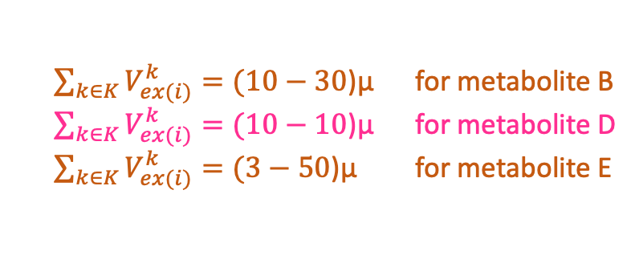
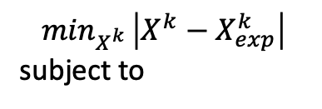
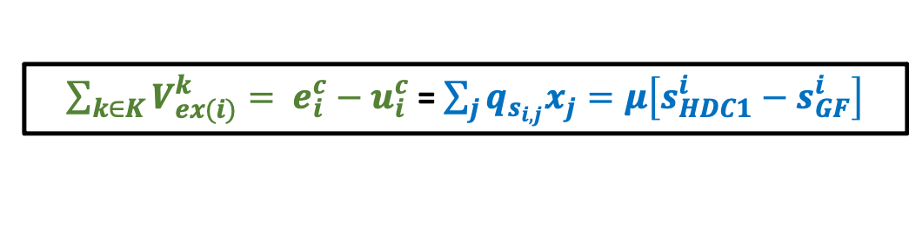
Community Metabolic Modelling and Validation Framework
$$\min_{X^{k} }\left|X^{k}−X_{exp}^{k}\right|$$
subject to
$\sum_{k∈K}{V_{ex(i)}^{k}= e_{i}^{c}−u_{i}^{c}}$ = $\sum_{j}{q_{s_{i,j}}x_{j}=μ\left[s_{HDC1}^{i}−s_{GF}^{i}\right]}$
$V_{j}^{k}=X^{k}v_{j}^{k}$, $∀j∈J^{k}$, $k∈K$
Metabolite name | Amount of metabolite (mmol per g of fecal matter) |  | Metabolite consumed or produced?
 | GF fecal sample | HDC1 fecal sample
A | 0 | 20 | Produced
B | 30 | 10 | Consumed
C | 10 | 50 | Produced
D | 10 | 10 | Unchanging
E | 50 | 3 | Consumed
$$\sum_{jεJ^{k}}{S_{ij}^{k}V_{j}^{k}=0}$$
$$∀i∈I^{k}$$
$$∀k∈K$$
${LB}_{j}^{k}X^{k}≤V_{j}^{k}≤{UB}_{j}^{k}X^{k}$,
$$∀j∈J^{k}$$
$$V_{biomass}^{k}=X^{k}μ$$
$$X^{k}≥0$$
$$u_{i}^{c}−e_{i}^{c}+\sum_{k∈K}{V_{ex(i)}^{k}=0,}$$
$$∀i∈I^{com}$$
Add the following as constraints:
$$\sum_{k∈K}{X^{k}=X_{0}}$$
$\sum_{k∈K}{V_{ex(i)}^{k}=(10−30}$)μ for metabolite B
$\sum_{k∈K}{V_{ex(i)}^{k}=(10−10}$)μ for metabolite D
$\sum_{k∈K}{V_{ex(i)}^{k}=(3−50}$)μ for metabolite E
$$μ$$
,
$$e_{i}^{c}≥0$$
,
$$∀i∈I^{com}$$

Slide 14
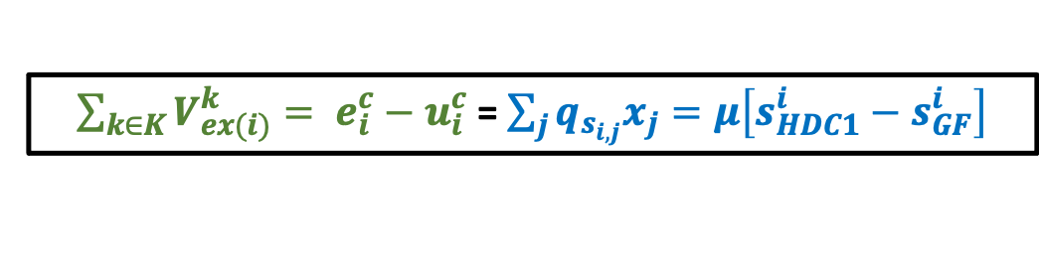
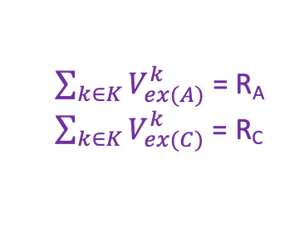
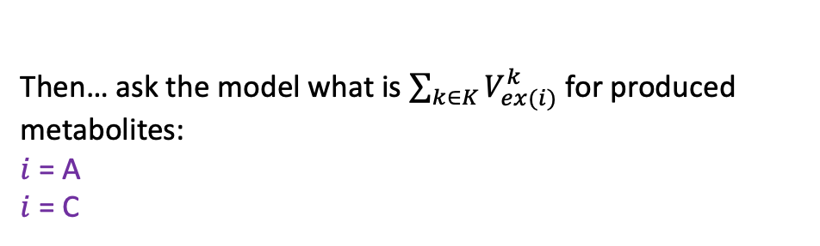
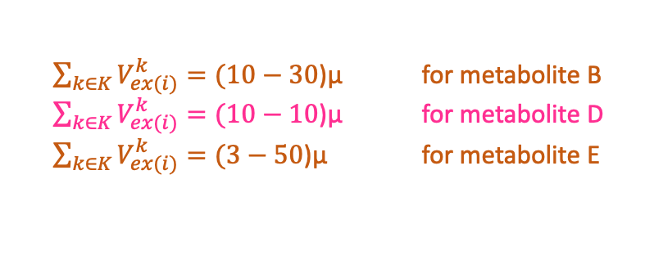
Community Metabolic Modelling and Validation Framework
$\sum_{k∈K}{V_{ex(i)}^{k}= e_{i}^{c}−u_{i}^{c}}$ = $\sum_{j}{q_{s_{i,j}}x_{j}=μ\left[s_{HDC1}^{i}−s_{GF}^{i}\right]}$
Add the following as constraints:
Metabolite name | Amount of metabolite (mmol per g of fecal matter) |  | Metabolite consumed or produced?
 | GF fecal sample | HDC1 fecal sample
A | 0 | 20 | Produced
B | 30 | 10 | Consumed
C | 10 | 50 | Produced
D | 10 | 10 | Unchanging
E | 50 | 3 | Consumed
$\sum_{k∈K}{V_{ex(i)}^{k}=(10−30}$)μ for metabolite B
$\sum_{k∈K}{V_{ex(i)}^{k}=(10−10}$)μ for metabolite D
$\sum_{k∈K}{V_{ex(i)}^{k}=(3−50}$)μ for metabolite E
Then… ask the model what is $\sum_{k∈K}{V_{ex(i)}^{k}}$ for produced metabolites:
$i$ = A
$i$ = C
Toy modelling results:
$\sum_{k∈K}{V_{ex(A)}^{k}}$ = R_{A}
$\sum_{k∈K}{V_{ex(C)}^{k}}$ = R_{C}
Determine predicted $s_{HDC1}^{i}$ in mmol per g of fecal matter for comparison to experimental results
Notes:
What is the overall flux of produced metabolites out of the community?

Slide 15

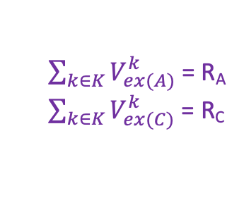


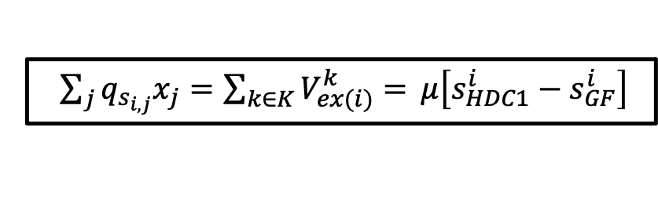

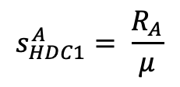
Community Metabolic Modelling and Validation Framework
$\sum_{k∈K}{V_{ex(i)}^{k}= e_{i}^{c}−u_{i}^{c}}$ = $\sum_{j}{q_{s_{i,j}}x_{j}=μ\left[s_{HDC1}^{i}−s_{GF}^{i}\right]}$
Toy modelling results:
Metabolite name | Amount of metabolite (mmol per g of fecal matter) |  | Metabolite consumed or produced?
 | GF fecal sample | HDC1 fecal sample
A | 0 | 20 | Produced
B | 30 | 10 | Consumed
C | 10 | 50 | Produced
D | 10 | 10 | Unchanging
E | 50 | 3 | Consumed
$\sum_{k∈K}{V_{ex(A)}^{k}}$ = R_{A}
$\sum_{k∈K}{V_{ex(C)}^{k}}$ = R_{C}
Determining predicted $s_{HDC1}^{i}$ in mmol per g of fecal matter for comparison to experimental results:
$\sum_{j}{q_{s_{i,j}}x_{j}=\sum_{k∈K}{V_{ex(i)}^{k}= }μ\left[s_{HDC1}^{i}−s_{GF}^{i}\right]}$
R_{A} = $μ\left[s_{HDC1}^{A}−0\right]$
R_{C} = $μ\left[s_{HDC1}^{C}−10\right]$
$$s_{HDC1}^{A}= \frac{R_{A}}{μ}$$
$s_{HDC1}^{C}= \frac{R_{C}}{μ}$ + 10
Compare to …

Slide 16
Extra slides

Slide 17
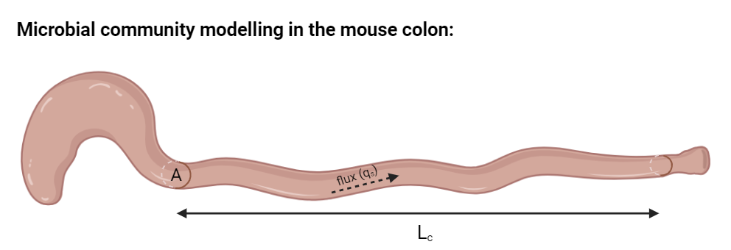
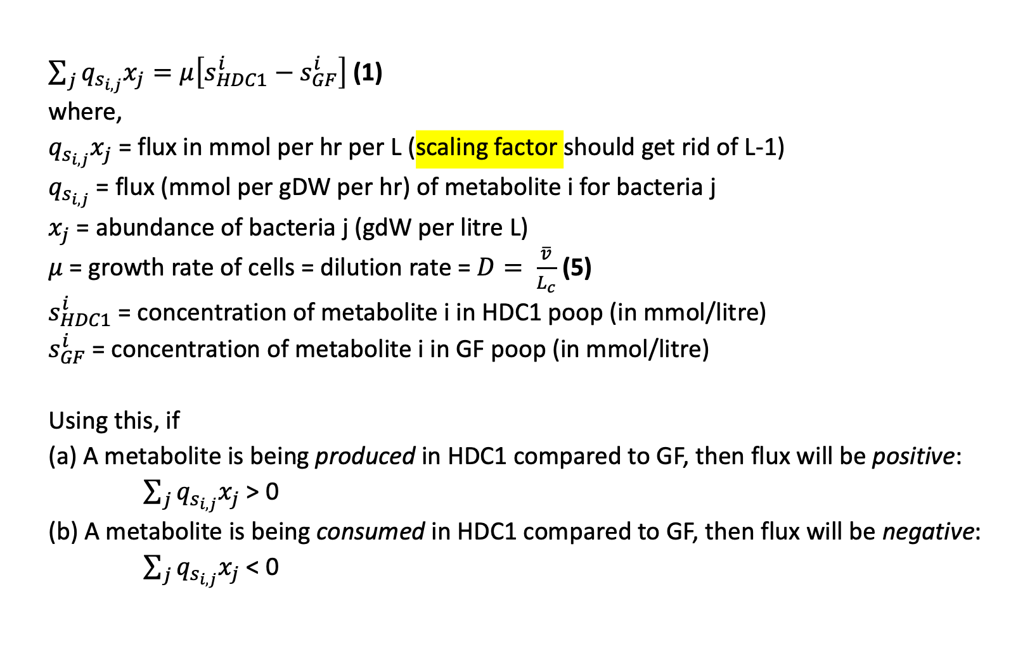
Modelling framework
$\sum_{j}{q_{s_{i,j}}x_{j}=μ\left[s_{HDC1}^{i}−s_{GF}^{i}\right]}$ (1)
where,
$q_{s_{i,j}}x_{j}$ = flux in mmol per hr per L (scaling factor should get rid of L-1)
$q_{s_{i,j}}$ = flux (mmol per gDW per hr) of metabolite i for bacteria j
$x_{j}$ = abundance of bacteria j (gdW per litre L)
$μ$ = growth rate of cells = dilution rate = $D= \frac{\overline{v}}{L_{c}}$ (5)
$s_{HDC1}^{i}$ = concentration of metabolite i in HDC1 poop (in mmol/litre)
$s_{GF}^{i}$ = concentration of metabolite i in GF poop (in mmol/litre)
Using this, if
(a) A metabolite is being produced in HDC1 compared to GF, then flux will be positive:
$\sum_{j}{q_{s_{i,j}}x_{j}}$ > 0
(b) A metabolite is being consumed in HDC1 compared to GF, then flux will be negative:
$\sum_{j}{q_{s_{i,j}}x_{j}}$ < 0
Created with BioRender

Slide 18
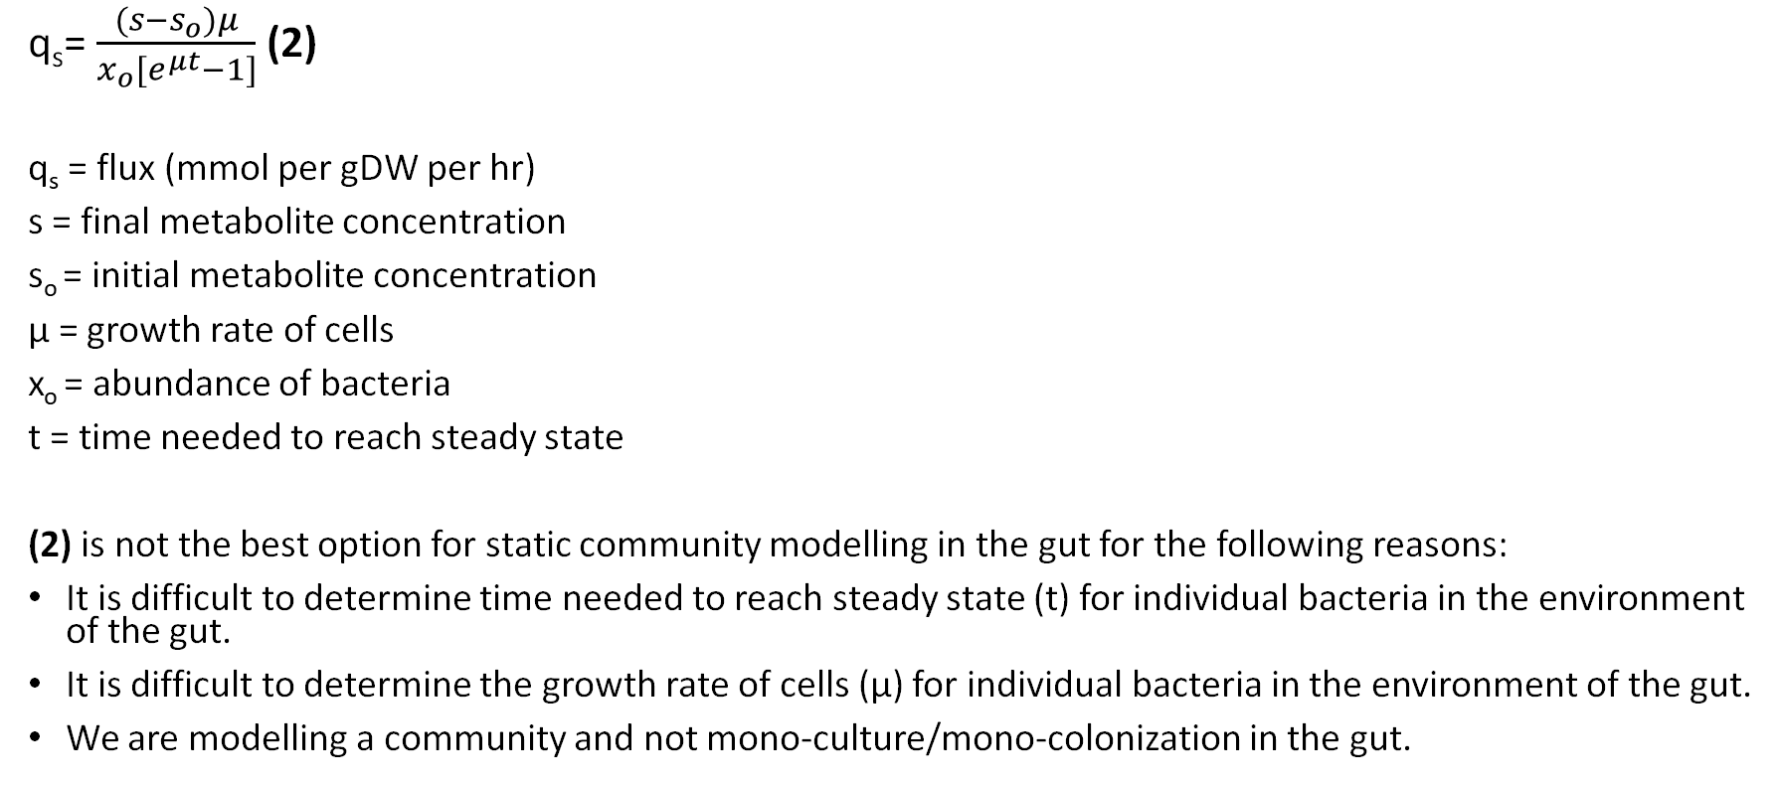
Modelling framework (derivation of eqn. 1)
q_{s}= $\frac{(s−s_{o})μ}{x_{o}[e^{μt}−1]}$ (2)
q_{s} = flux (mmol per gDW per hr)
s = final metabolite concentration
s_{o} = initial metabolite concentration
μ = growth rate of cells
x_{o} = abundance of bacteria
t = time needed to reach steady state
(2) is not the best option for static community modelling in the gut for the following reasons:
It is difficult to determine time needed to reach steady state (t) for individual bacteria in the environment of the gut.
It is difficult to determine the growth rate of cells (µ) for individual bacteria in the environment of the gut.
We are modelling a community and not mono-culture/mono-colonization in the gut.

Slide 19
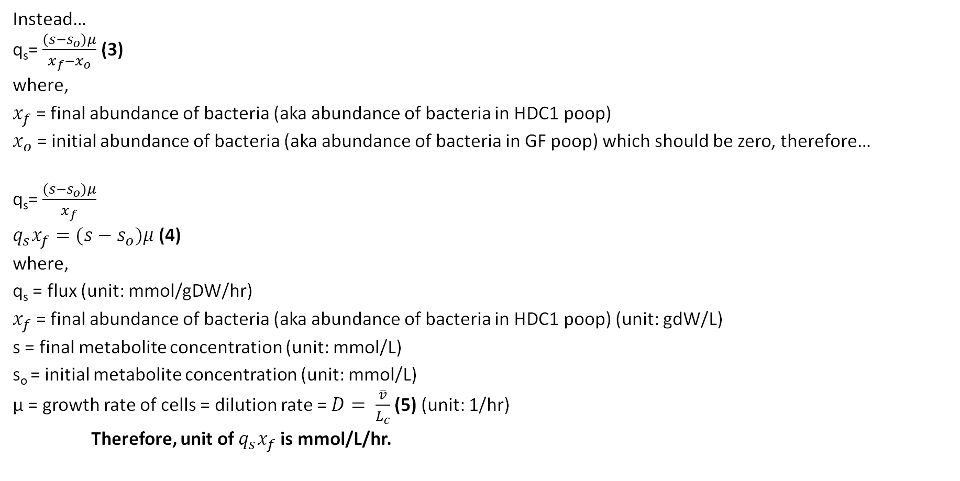
Modelling framework (derivation of eqn. 1)
Instead…
q_{s}= $\frac{(s−s_{o})μ}{x_{f}−x_{o}}$ (3)
where,
$x_{f}$ = final abundance of bacteria (aka abundance of bacteria in HDC1 poop)
$x_{o}$ = initial abundance of bacteria (aka abundance of bacteria in GF poop) which should be zero, therefore…
q_{s}= $\frac{(s−s_{o})μ}{x_{f}}$
$q_{s}x_{f}=(s−s_{o})μ$ (4)
where,
q_{s} = flux (unit: mmol/gDW/hr)
$x_{f}$ = final abundance of bacteria (aka abundance of bacteria in HDC1 poop) (unit: gdW/L)
s = final metabolite concentration (unit: mmol/L)
s_{o} = initial metabolite concentration (unit: mmol/L)
µ = growth rate of cells = dilution rate = $D= \frac{\overline{v}}{L_{c}}$ (5) (unit: 1/hr)
Therefore, unit of $q_{s}x_{f}$ is mmol/L/hr.

Slide 20
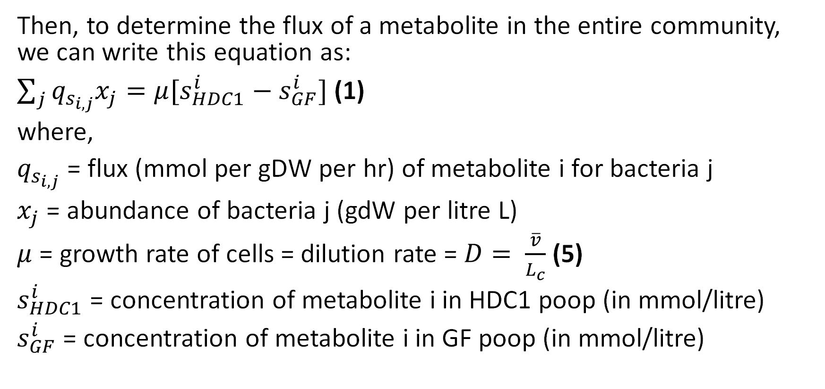
Modelling framework (derivation of eqn. 1)
Then, to determine the flux of a metabolite in the entire community, we can write this equation as:
$\sum_{j}{q_{s_{i,j}}x_{j}=μ[s_{HDC1}^{i}−s_{GF}^{i}]}$ (1)
where,
$q_{s_{i,j}}$ = flux (mmol per gDW per hr) of metabolite i for bacteria j
$x_{j}$ = abundance of bacteria j (gdW per litre L)
$μ$ = growth rate of cells = dilution rate = $D= \frac{\overline{v}}{L_{c}}$ (5)
$s_{HDC1}^{i}$ = concentration of metabolite i in HDC1 poop (in mmol/litre)
$s_{GF}^{i}$ = concentration of metabolite i in GF poop (in mmol/litre)

Slide 21

Modelling framework
$μ=D= \frac{\overline{v}}{L_{c}}$ (5)
where,
D = dilution rate = µ = rate of peristalsis (1/time)
$\overline{v}$ = average velocity (distance $L_{c}$/time)
L_{c} = length of colon
Notes:
Note that dilution rate equals to growth rate.

Slide 22
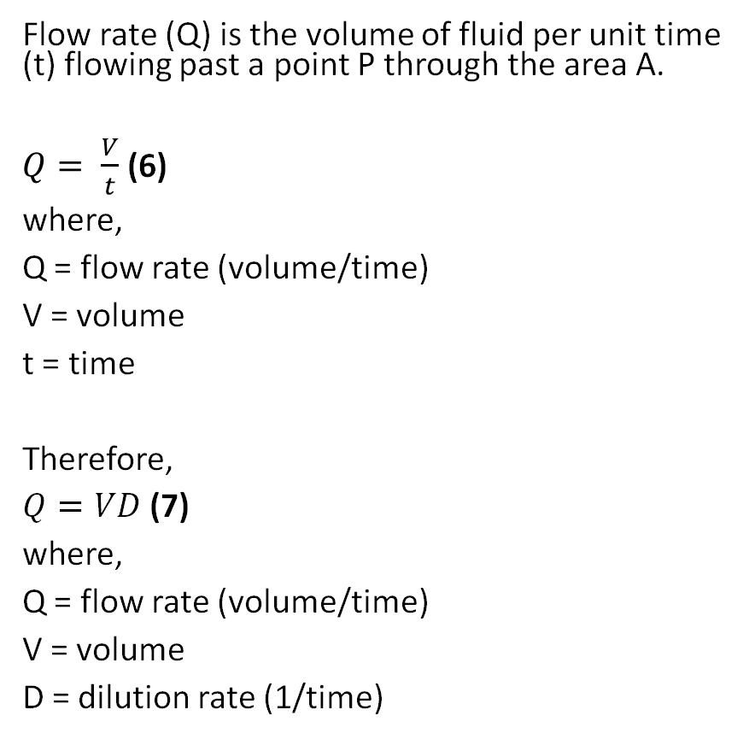
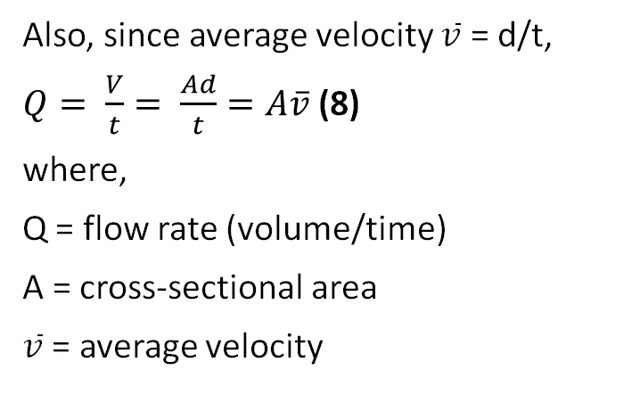
Modelling framework (Derivation of eqn. 5)
Flow rate (Q) is the volume of fluid per unit time (t) flowing past a point P through the area A.
$Q= \frac{V}{t}$ (6)
where,
Q = flow rate (volume/time)
V = volume
t = time
Therefore,
$Q=VD$ (7)
where,
Q = flow rate (volume/time)
V = volume
D = dilution rate (1/time)
Also, since average velocity $\overline{v}$ = d/t,
$Q= \frac{V}{t}= \frac{Ad}{t}=A\overline{v}$ (8)
where,
Q = flow rate (volume/time)
A = cross-sectional area
$\overline{v}$ = average velocity
Notes:
Flow rate (Q) and velocity ($\overline{v}$ ) are related but quite different physical quantities:
The greater the velocity of the water, the greater the flow rate of a river, for example…
… but flow rate also depends on the size of the river since a rapid mountain stream would carry far less water than the Amazon River in Brazil, for example.
Therefore, the relationship between flow rate and velocity is: Q = A$\overline{v}$

Slide 23

Modelling framework (Derivation of eqn. 5)
Since $D= \frac{Q}{V}$ (7), $Q=A\overline{v}$ (8) and $V=AL_{c}$ (9),
then
$D= \frac{Q}{V}= \frac{A\overline{v}}{AL_{c}}= \frac{\overline{v}}{L_{c}}= µ$ (5)
where,
D = dilution rate = µ = rate of peristalsis (1/time)
Q = flow rate (volume/time)
V = volume
A = cross-sectional area of the colon
$\overline{v}$ = average velocity
L_{c} = length of colon

Slide 24
SteadyCom

Slide 25
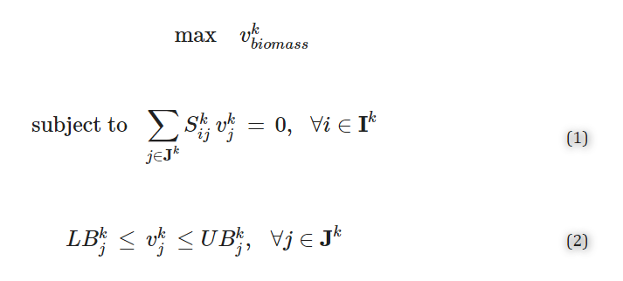

Joint FBA
FBA:
Let K be the set of all organisms in the community.
For an organism k in K, the traditional FBA for predicting maximum growth can be stated as follows:
where,
$v_{j}^{k}$ is the flux of reaction j (in mmol gdw⁻¹h⁻¹ for general metabolic reactions, in g gdw⁻¹h⁻¹ for the biosynthesis of macromolecules, and in h⁻¹ for the biomass reaction)
$S_{ij}^{k}$ is the stoichiometry for metabolite i in reaction j
${LB}_{j}^{k}$ and ${UB}_{j}^{k}$ are the lower bound and upper bounds for fluxes $v_{j}^{k}$ , respectively
I ^{k} and J ^{k} are respectively the set of metabolites and reactions for organism k

Slide 26
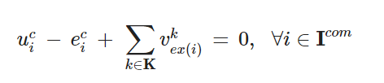
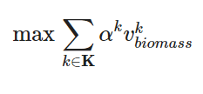
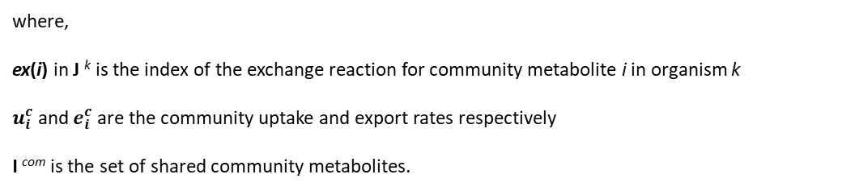
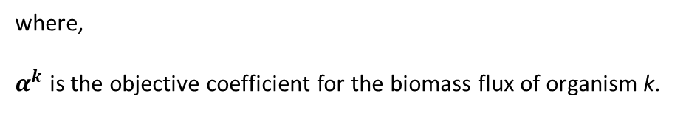
Joint FBA
Microbial communities have generally been treated as multi-compartment models.
The extracellular compartments of various organisms are connected by an additional compartment (called community space).
The mass balance for metabolites in the community space (termed community metabolites) is described as:
where,
ex(i) in J ^{k} is the index of the exchange reaction for community metabolite i in organism k
$u_{i}^{c}$ and $e_{i}^{c}$ are the community uptake and export rates respectively
I ^{com} is the set of shared community metabolites.
(3)
The objective function for the community model is defined so as to include the sum of the biomass fluxes for each organism:
where,
$α^{k}$ is the objective coefficient for the biomass flux of organism k.
(4)
Eqs (1)–(4) form the joint FBA optimization formulation for assessing the metabolic flows in microbial communities.

Slide 27
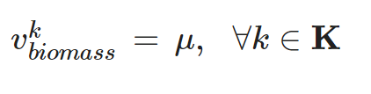
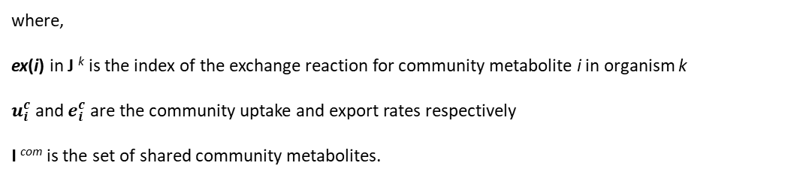
Joint FBA: Problems
Problem 1: Eq (3) implicitly assumes that each species has an identical biomass or relative abundance by modeling the metabolite exchange in the community space as the direct sum of the specific rates of individual organisms.
where,
ex(i) in J ^{k} is the index of the exchange reaction for community metabolite i in organism k
$u_{i}^{c}$ and $e_{i}^{c}$ are the community uptake and export rates respectively
I ^{com} is the set of shared community metabolites.
(3)
Problem 2: A stable steady-state in the community is not guaranteed with the joint FBA formulation since metabolic flux distributions satisfying a community steady-state cannot be derived under this treatment.
To remedy this shortcoming in SteadyCom, they derived a necessary and sufficient condition for the requirement of a constant community composition (i.e. community steady-state). Under the assumption of identical dilution rates for all organisms in the community, the condition is simplified into an identical specific growth rate for all organisms:
(5)
where μ is the community growth rate
Note that the requirement of identical growth rate between all microbial partners at steady-state applies not at every time point but averaged over the time interval of the study.

Slide 28
Deriving SteadyCom Constraints
They derived a community-modelling framework that includes a constraint to enforce steady-state, and a restriction to force zero flux through an organism with zero abundance.
This is because with joint FBA:
When multiple organisms are growing together, the framework does not necessarily impose any restrictions on the growth rate of all participating members in the community. This lack of constant growth rate across all microbes in the community may lead to metabolic fluxes inconsistent with an unchanging average community composition (community steady-state), as the fastest growing organism will take over the population. In the human gut microbiota, experimental studies suggest the existence of stable steady-states around which the gut microbiome stays near.
Solutions in which a non-growing organism can provide substrates to a growing organism are permitted. This is not sustainable since the feeding capability of the non-growing organism will need to increase in proportion with the increasing amount of biomass of the growing organism.
Solution: this issue originates from the lack of distinction between two different quantities that describe growth:
the specific rate of the amount of substrate utilized per unit time per unit biomass that used in single-organism FBA, and
the exchange rate between an entire population of an organism and the extracellular environment → it represents the total amount of substrate per unit time = the specific rate times the biomass of the population = aggregate flux.
As such, the aggregate flux correctly quantifies the metabolites that an organism can consume or produce in a microbial community of non-uniform relative abundances because you get rid of the biomass factor.

Slide 29
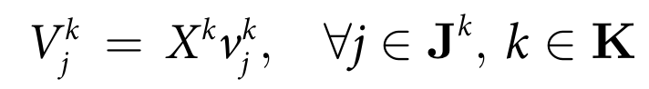
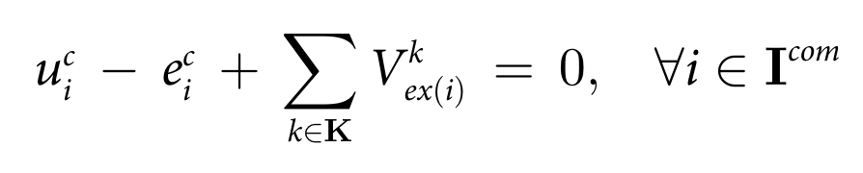
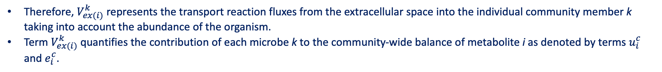
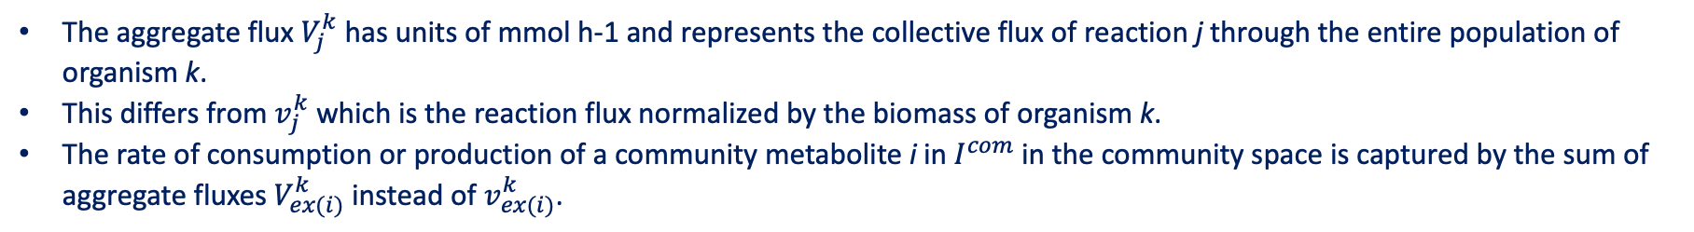
Deriving SteadyCom Constraints: Aggregate Flux
The biomass (in gdw) for organism k is explicitly modelled as the variable $X^{k}$. A new flux quantity called the aggregate flux $V_{j}^{k}$ for reaction j of organism k is introduced:
(6)
The aggregate flux $V_{j}^{k}$ has units of mmol h-1 and represents the collective flux of reaction j through the entire population of organism k.
This differs from $v_{j}^{k}$ which is the reaction flux normalized by the biomass of organism k.
The rate of consumption or production of a community metabolite i in $I^{com}$ in the community space is captured by the sum of aggregate fluxes $V_{ex(i)}^{k}$ instead of $v_{ex(i)}^{k}$.
By introducing the aggregate flux, the exchange of community metabolites between individual organisms in the community space can be properly expressed with the following mass-balance equation in the community space analogous to Eq (3):
(3)
(7)
Therefore, $V_{ex(i)}^{k}$ represents the transport reaction fluxes from the extracellular space into the individual community member k taking into account the abundance of the organism.
Term $V_{ex(i)}^{k}$quantifies the contribution of each microbe k to the community-wide balance of metabolite i as denoted by terms $u_{i}^{c}$ and $e_{i}^{c}$.

Slide 30



Deriving SteadyCom Constraints: Aggregate Flux
Eqs (1) and (2) can be expressed in terms of the aggregate flux by multiplying each equation by $X^{k}$ for each organism k in K:
(8)
(9)
This establishes the mass balance and flux capacity constraints in terms of the aggregate flux and biomass variables.
Starting from Eq (5) the community steady-state condition is restated so as to relate $X^{k}$, μ and the aggregate biomass production $V_{biomass}^{k}:$
(5)
(10)

Slide 31


Deriving SteadyCom Constraints: Aggregate Flux
A non-zero total biomass $X_{o}$ for the community is defined since if $V_{j}^{k}=X^{k}=0$ for all j and k, Eqs (7)–(10) are satisfied regardless of the value of μ.
(11)

Slide 32



SteadyCom
Using Eqs (7)–(11), the maximum community growth rate $μ_{max}$ of a community satisfying the community steady-state can be found by solving the following non-linear optimization problem termed SteadyCom:
The community export rates $e_{i}^{c}$ and uptake rates $u_{i}^{c}$ are normalized for one unit of total community biomass, therefore $X_{0}$ is set at 1 gdw and $X^{k}$ is thus equal to the relative abundance of organism k.

Slide 33
SteadyCom
The flux distributions predicted by SteadyCom satisfy two important properties that are fundamentally different from the prediction by joint FBA:
The community steady-state encoded in Eq (10) enforces an identical time-averaged growth rate for all organisms in the community such that the predicted community composition remains stable over time.
(5)
(10)
2. The coupling between the biomass and the aggregate flux by Eq (9) ensures that for a growing community, an organism can have non-zero fluxes if and only if both its total biomass and biomass production rate are non-zero. A non-growing organism in a growing community will quickly become extinct and therefore it will be unable to contribute to community metabolite exchange at a community steady-state.
(8)
(9)

